Slide 1
NETime Planner
Project Authors:
Kevin DeMars
Trenton Strickland
Eric Jaroszewski
Joshua Kanagasabai
Max Cadeddu
Samuel Kim

Slide 2
Project Vision
NETime (pronounced "any time") Planner is a social planner focused on students.
In addition to the basic actions of managing personal deadlines and activities, it supports sharing schedules and collaborating on schedules with groups. Our goal is to make managing your schedule simple and convenient, with helpful features such as automatically appending events to your next free time.
The features don't stop as soon as you've entered your info into your schedule. NETime Planner provides features to analyze your schedule, giving you feedback on what percentage of time you have left for deadlines, how much free time you have each week, and more.

Slide 3
Highlighted Features
User Profile
Create Profile
Edit Profile
View Schedule

Slide 4
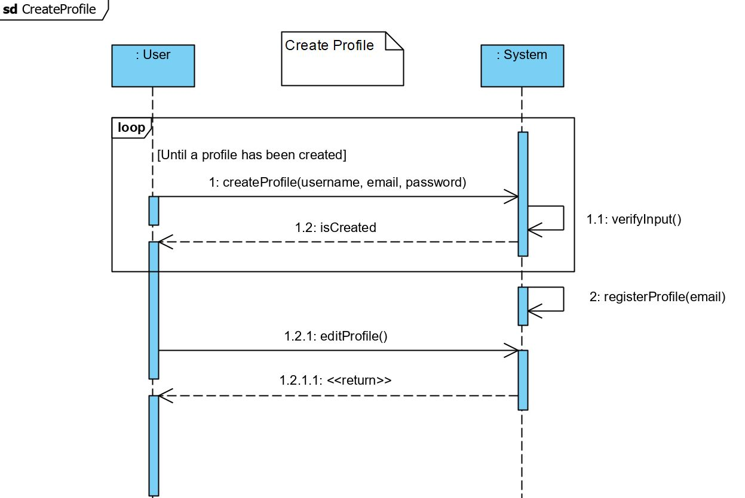
SSD

Slide 5
Highlighted Features
Deadlines & Activities
Create
Edit
Remove

Slide 6
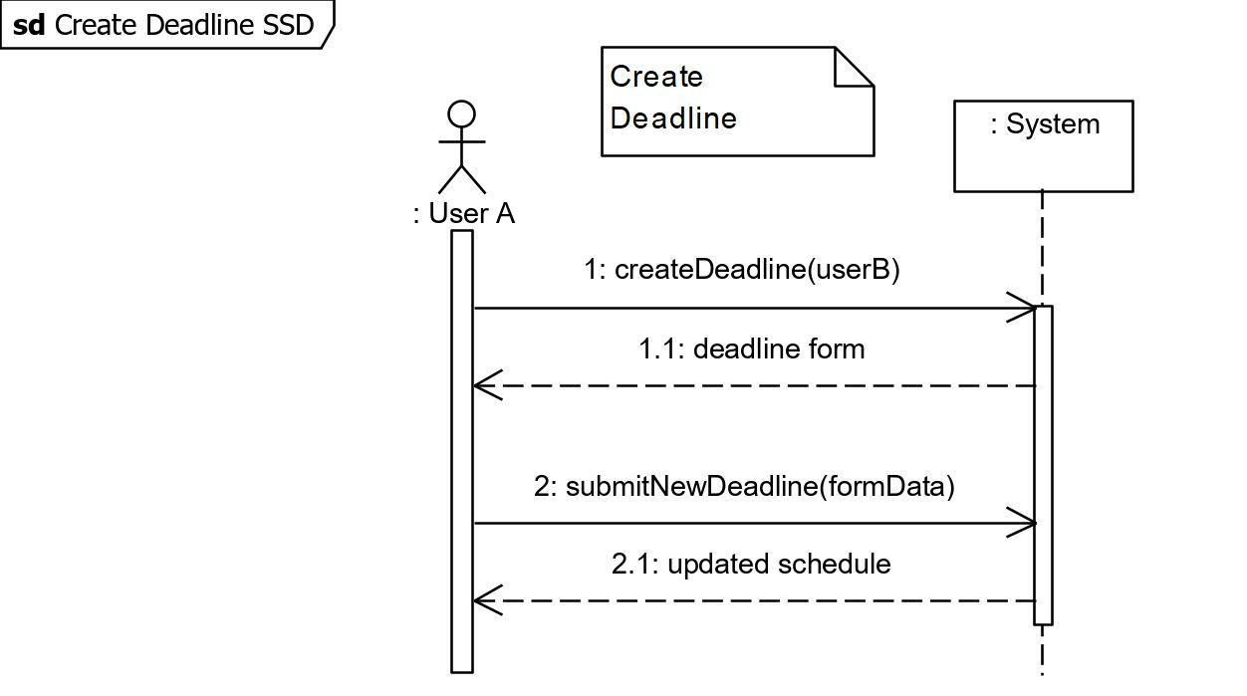
SSD

Slide 7
Highlighted Features
Groups
Create
Edit
Delete
Edit Permissions

Slide 8
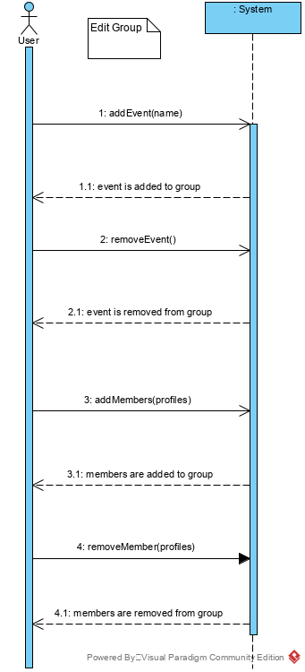
SSD

Slide 9
Highlighted Features
Able to Share
Schedules
Events
Edit Privacy Settings

Slide 10
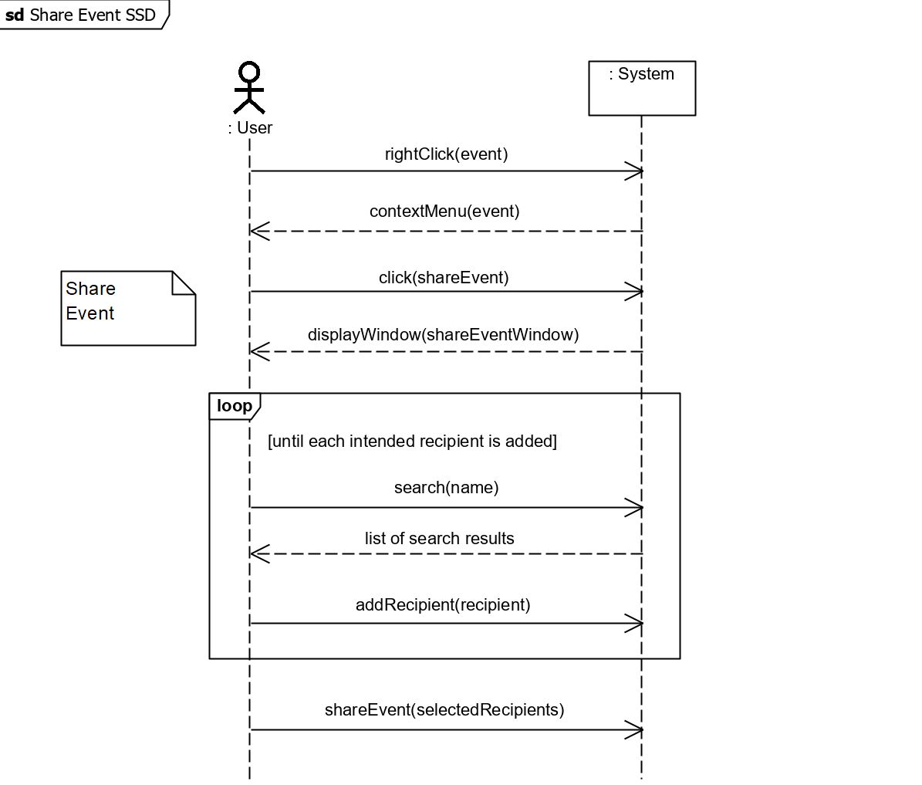
SSD

Slide 11
Highlighted Features
Time Statistics & Calculations
Calculate Free Time
Time left on Task
Time Spent on Task

Slide 12
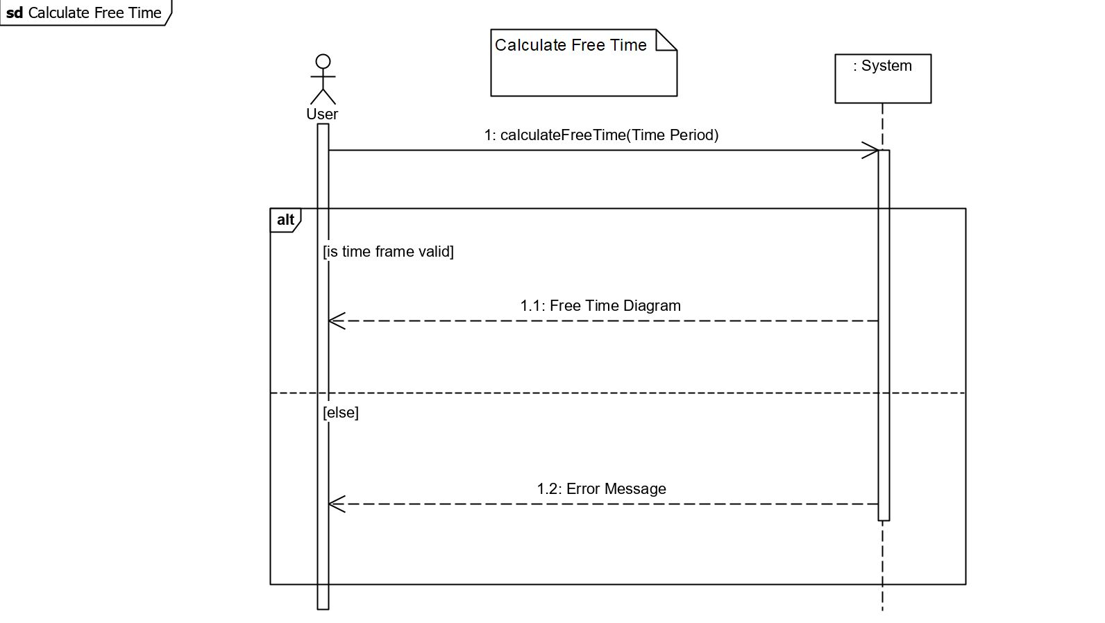
SSD

Slide 13
Highlighted Features
Schedule Operations
Assign Work Time
Auto – Append Event
Generate To-Do List

Slide 14
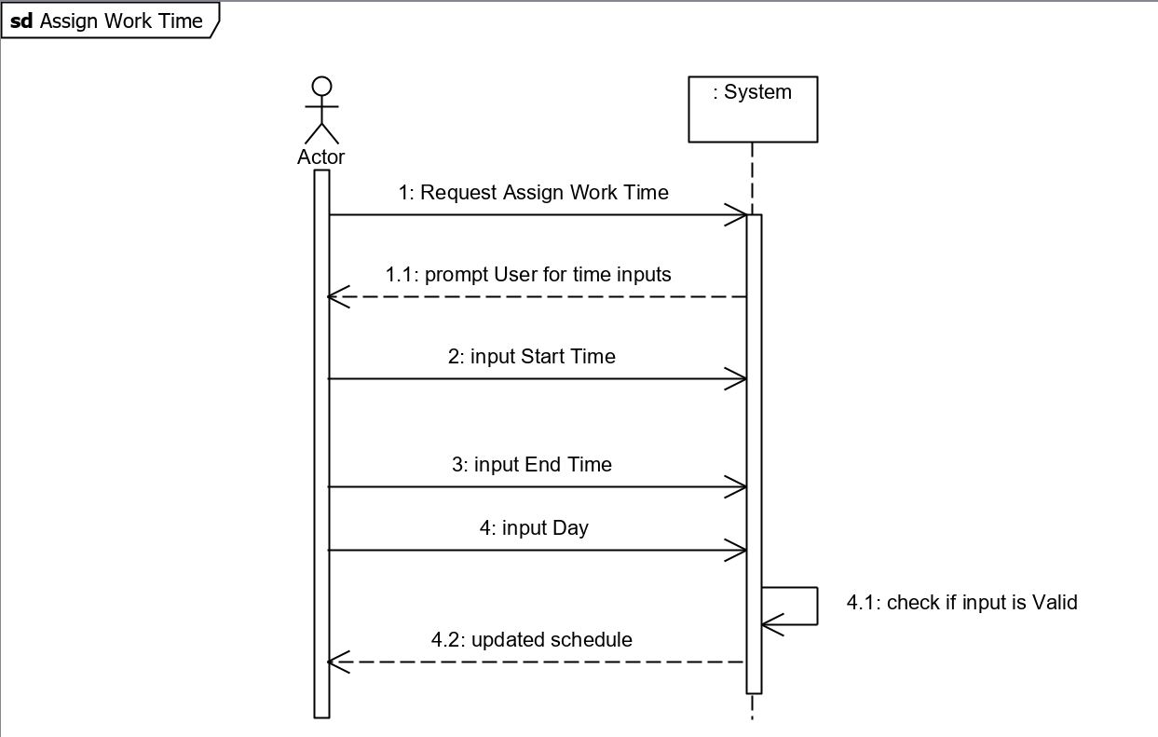
SSD

Slide 15
Wireframes

Slide 16

Username
Password
Login
Sign Up

Slide 17
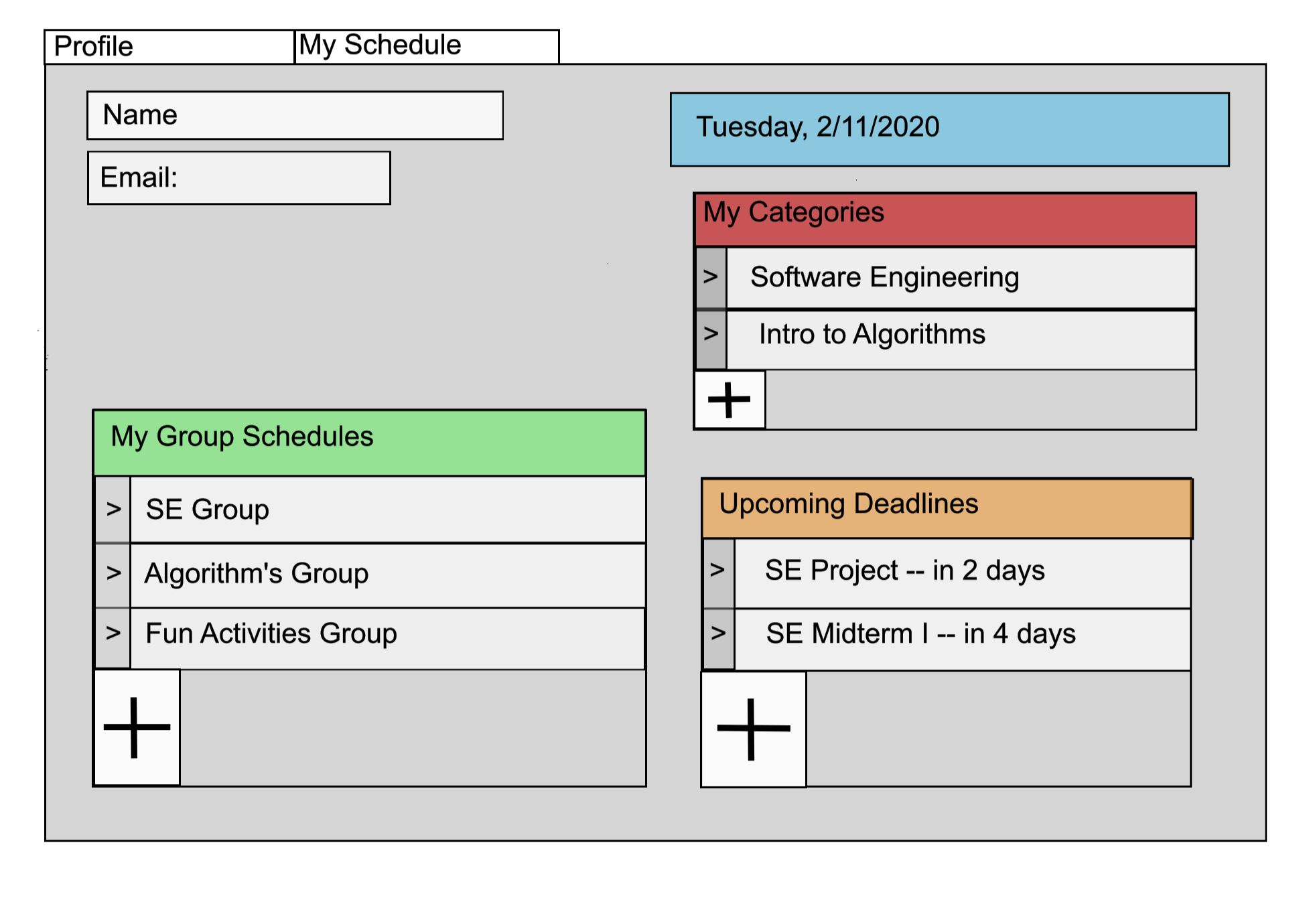

Slide 18
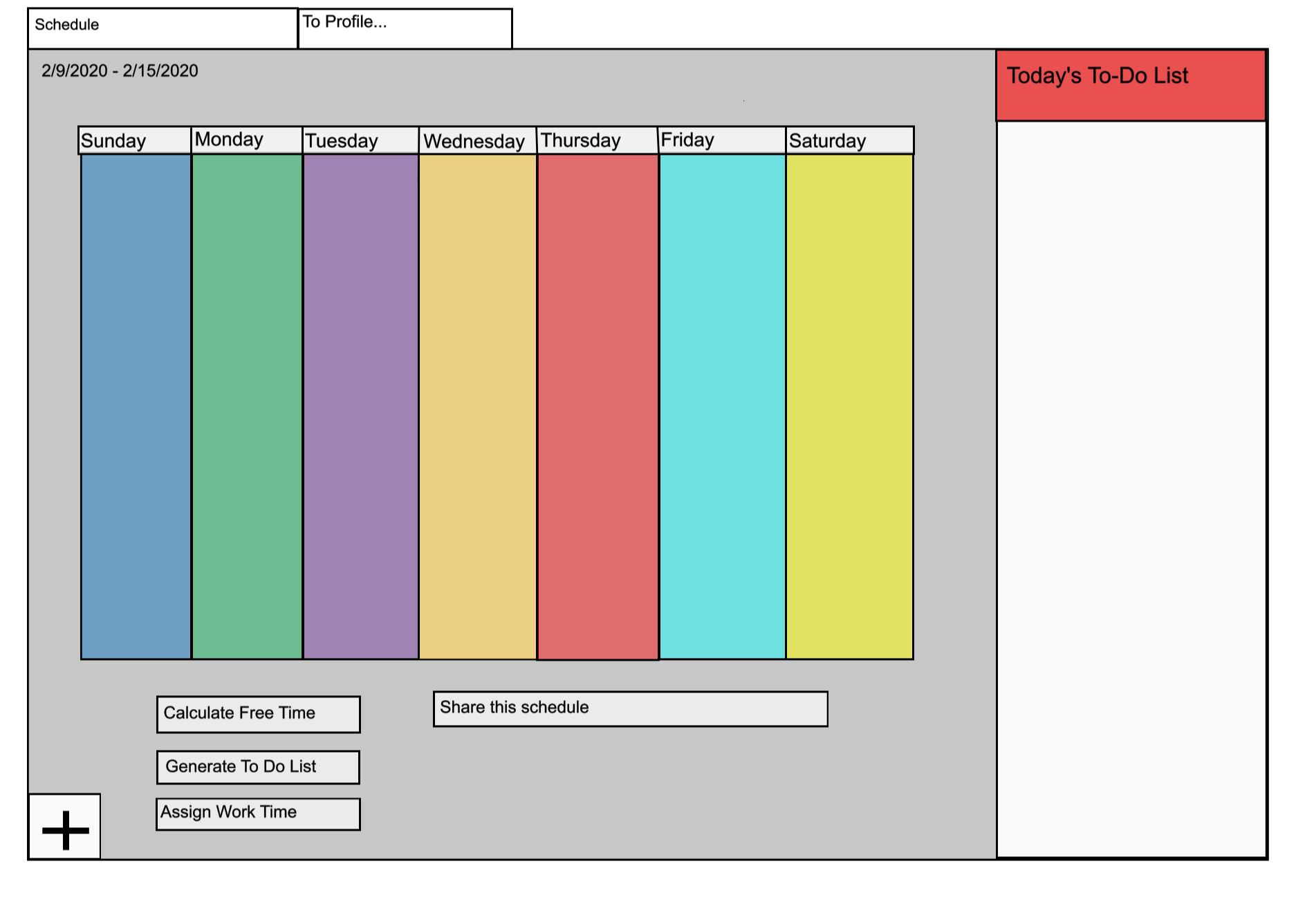

Slide 19
Domain Model

Slide 20
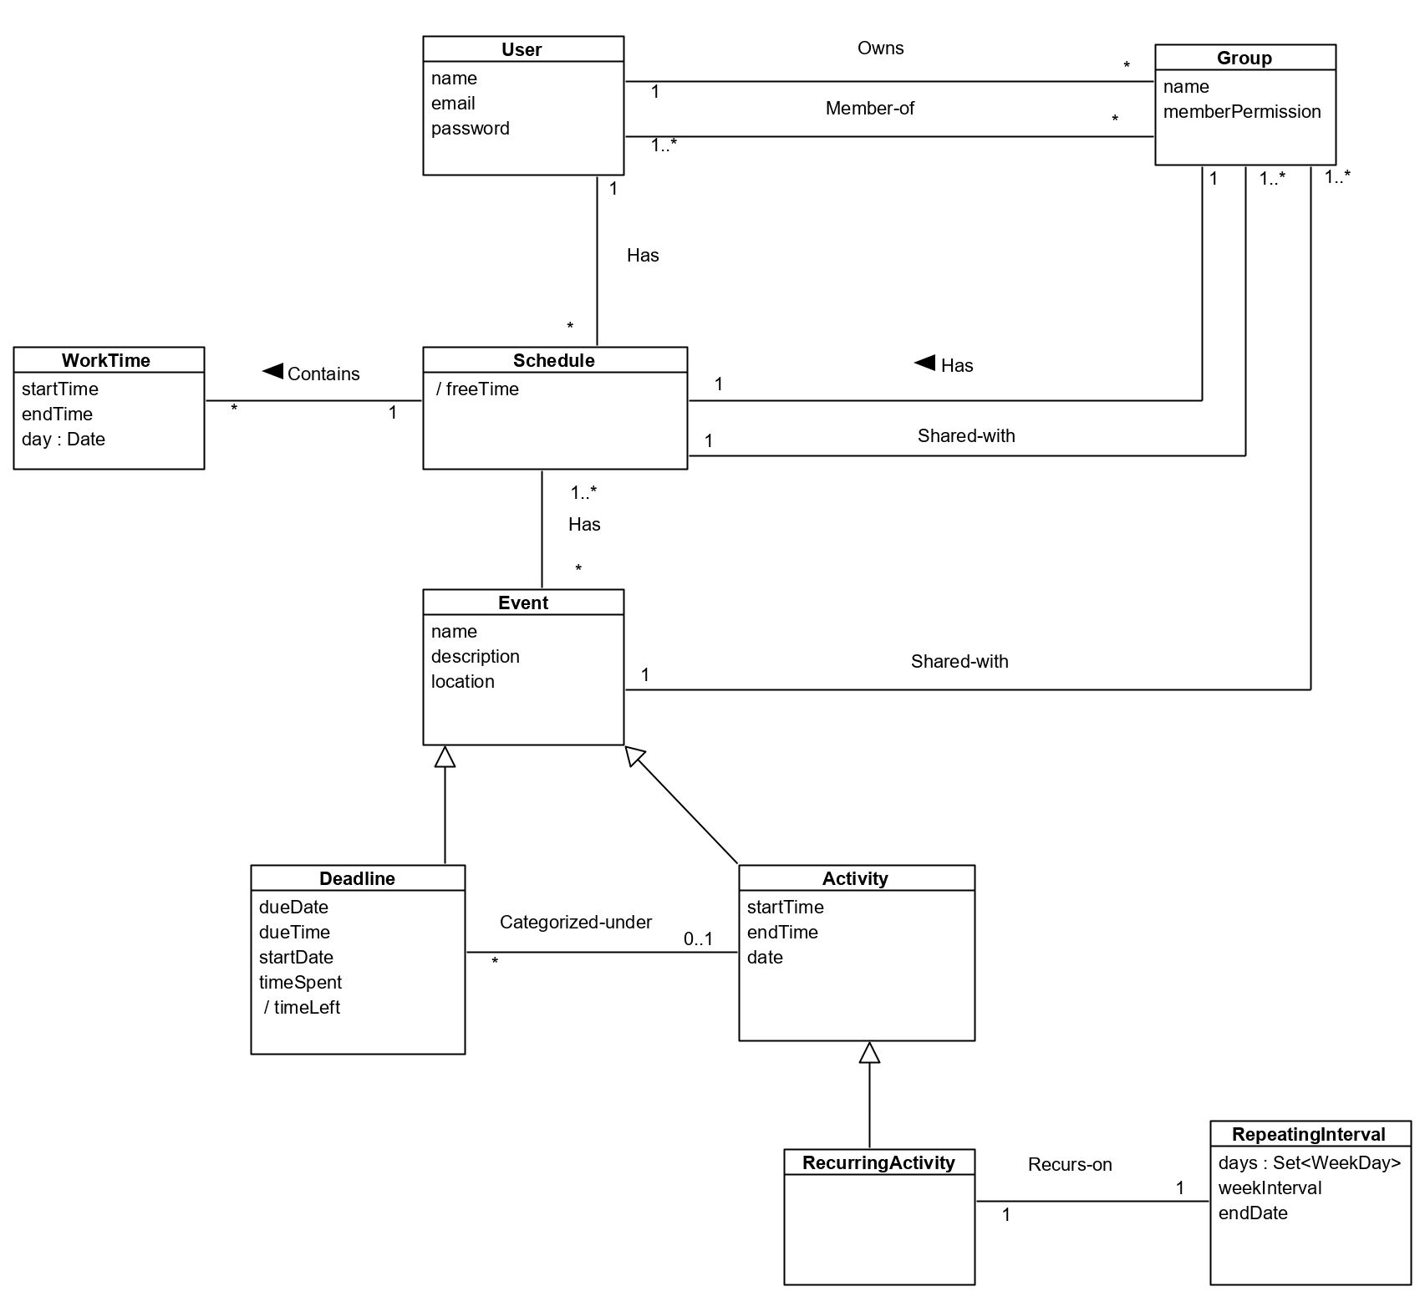

Slide 21

Website & Questions?
Website | https://kevindemars.github.io/netime-planner
GitHub Repo: | https://github.com/KevinDeMars/netime-planner/issues

